Slide 1

Personalized PageRank to a Target Node, Revisited
Hanzhi Wang, Zhewei Wei*, Junhao Gan, Sibo Wang, and Zengfeng Huang
Contact: zhewei@ruc.edu.cn
Notes:
Hello everyone, I’m Hanzhi Wang and I’m going to talk about our work: “Personalized PageRank to a Target Node, revisited”. This work is cooperated with my supervisor professor Zhewei Wei at Renmin University of China, professor Junhao Gan from the University of Melbourne, professor Sibo Wang from the Chinese University of HongKong, and professor Zengfeng Huang from Fudan Univeristy.

Slide 2
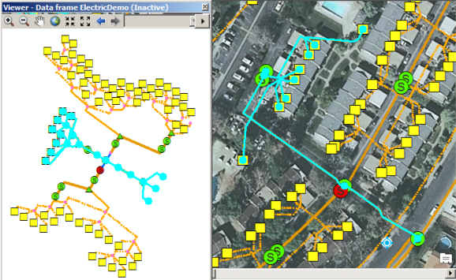
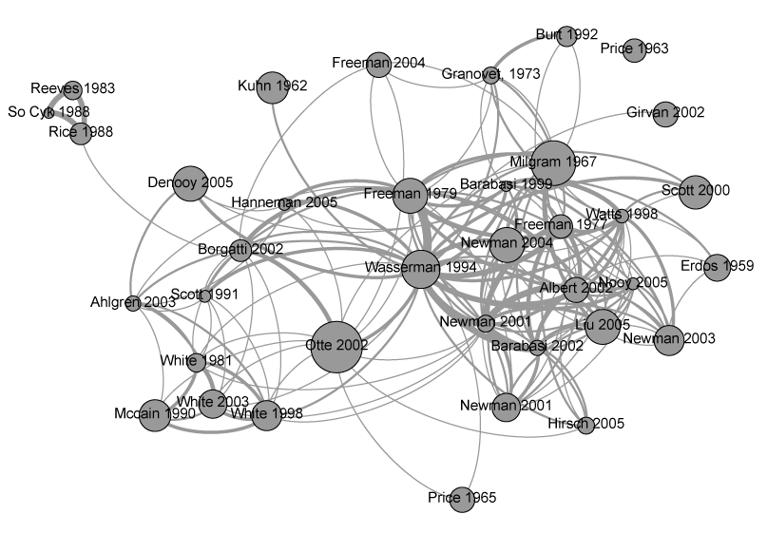
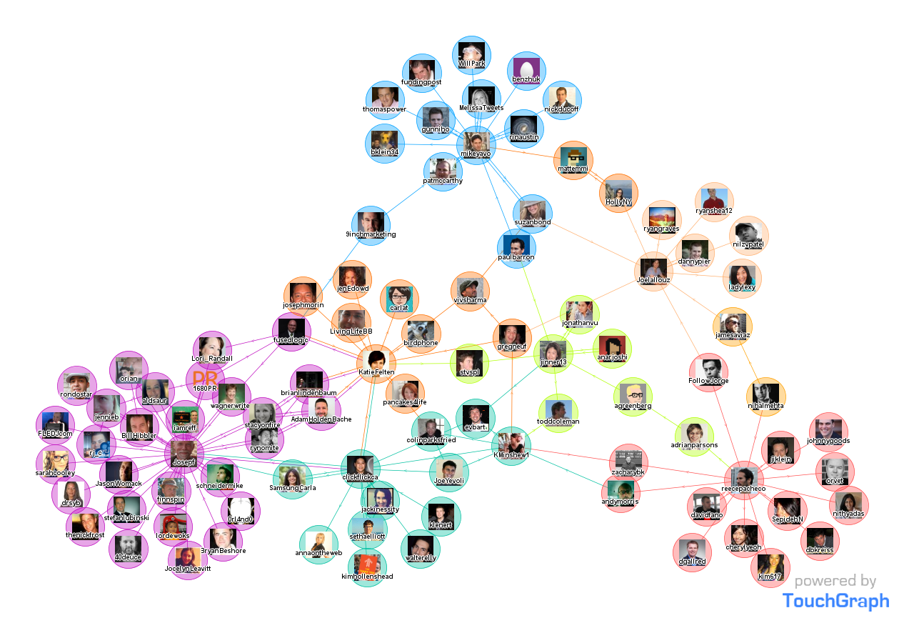
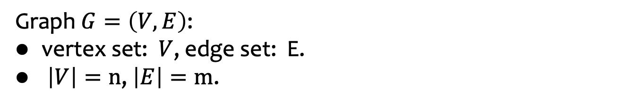
Graph
Graph $G=\left(V,E\right)$:
vertex set: $V$, edge set: E.
$\left|V\right|=n$, $\left|E\right|=m$.
geographic network
paper citation network
social network
Notes:
In our life, there are many network structures, such as social network, paper citation network, geographic network and so on. We can abstract these network structures into a graph G. A graph is composed by nodes and the edges connecting the nodes. We always use V to denote the vertex set, and E to denote the edge set. The number of nodes and edges is denoted by n and m.

Slide 3
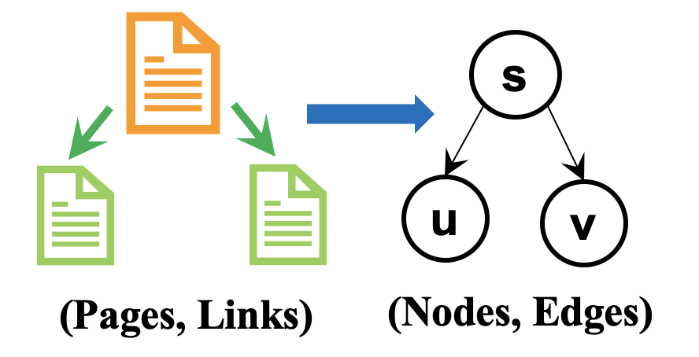

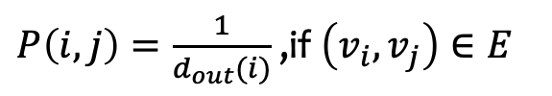
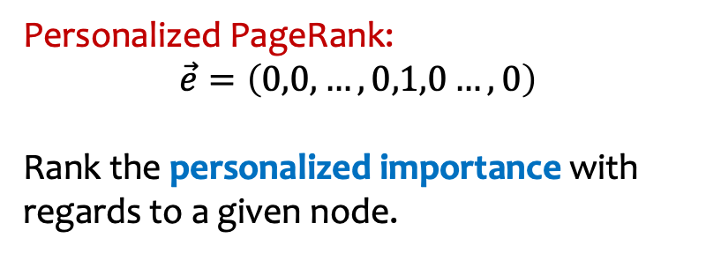


PageRank and Personalized PageRank
PageRank: the importance rank of web pages.
  If a page is cited by more pages, it is more important.
  If a page is cited by more important pages, it is more important.
Power method for PageRank: $\vec{π}=\left(1−α\right)\vec{π}P+α∙\vec{e}$
  $\vec{π}$: the PageRank vector. $\vec{e}$: initialization vector.
  $P$: transformation matrix. $α$: teleport probability.
$P\left(i,j\right)=\frac{1}{d_{out}(i)}$ ,if $\left(v_{i},v_{j}\right)∈E$
PageRank: $\vec{e}=\left(\frac{1}{n},\frac{1}{n},…,\frac{1}{n}\right)$
Rank the overall importance of a node.
Personalized PageRank:
$$\vec{e}=\left(0,0, …,0,1,0…,0\right)$$
Rank the personalized importance with regards to a given node.
the s-th entry
Notes:
Given a graph, we always want to rank the importance of a node. PageRank is a popular measurement for node rank. It is proposed by the co-founders of Google to rank the web pages in web networks. The idea of PageRank is that if a page is cited by more pages, or more important pages, then the page is more important.
(Click!)If we abstract the web network into a graph, that is we use nodes to represent the web pages, and edges to represent the links among pages, (Click!)
then we can use an iterative formula to derive the PageRank score for each node on the graph. Observing the iterative formula, it has an initialization vector e and a transformation matrix P.
(Click!)The transformation matrix P store the probability that a node transfer to one of its out-neighbors through the out-edges. For example, if a node has five out-neighbors, then the corresponding probability stored in matrix P is 1 over 5. In each iteration, the formula use the current PageRank vector pi times the matrix P to transfer the PageRank scores to the out-neighbors. The updated PageRank scores are composed by 1 minus alpha times the current PageRank scores and alpha times the initialization scores. If we modify the value of initialization vector e, we can change the meaning of the rank.
In detail, (Click!)if we set each entry of e is 1 over n, then the iterative formula will converge to the PageRank scores to rank the overall importance of nodes. (Click!)Personalized PageRank is a special case of PageRank, that we set the initialization vector as a one hot vector, each entry is 0 except the s_th entry is 1. (Click!) Then the rank reveals the personalized importance with regards to the node s.
Well, Personalized PageRank, or PPR for short, is a measurement for proximity.
(Click!)Specifically, the PPR value pi(s,t) equals the probability that the alpha-discounted random walk starting from node s terminates at node t.
(Click!)Here the alpha-discounted random walk means the walk may terminate at each step with the probability alpha, or move to a random out-neighbor with the probability 1 minus alpha.
(Click!)So actually, the PPR value pi(s,t) indicates the importance of node t with regards to node s.

Slide 4















Personalized PageRank (PPR)
10
9
$$α$$
12
2
$$1−α$$
$$1−α$$
$$1−α$$
$$1−α$$
$$α$$
$$1−α$$
8
1
3
11
$$1−α$$
$$α$$
$$1−α$$
$$1−α$$
4
$$1−α$$
$$1−α$$
$$α$$
$α$-discounted random walk:
$$1−α$$
$$1−α$$
6
5
terminates at the current node, w.p. $α$
moves to a random out-neighbor, w.p. $1−α$
7
PPR $π(s,t)$=Pr{the $α$-walk starting from $s$ terminates at $t$}
Notes:
By the iterative formula, we can also view the meaning of Personalized PageRank value, or PPR value for short, from the probability aspect.
(Click)The PPR value pi(s,t) equals to the probability that the alpha discounted random walk starting from node s terminates at node t.
Here, the alpha discounted random walk means at each step, the walk either terminates at the current node with alpha probability, or moves to a randomly selected out-neighbor with the probability 1 minus alpha.
So in this aspect, we can regard PRR as a metric for node proximity.
We define an alpha discounted random walk from u to be a traversal of G. At each step, either terminates at the current node with alpha probability, or proceeds to a randomly selected out-neighbor of current node. PPR(u,v) is the probability that random walk from u terminates at v.

Slide 5



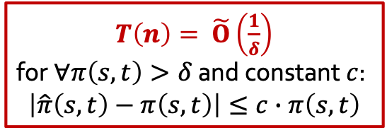


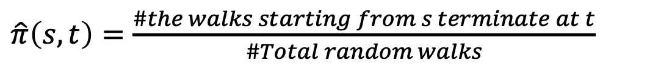




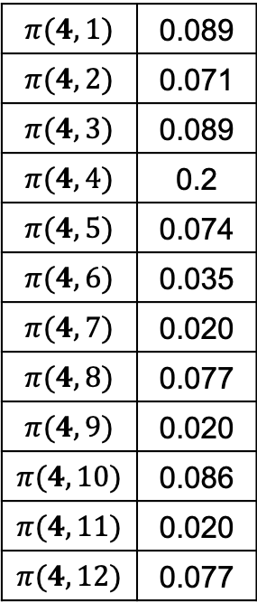
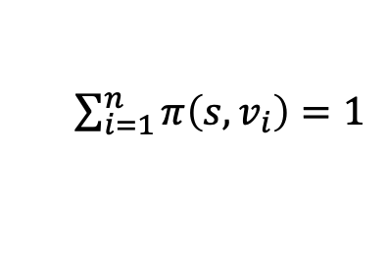


Single-Source PPR Query
10
9
$$α$$
12
($α=0.2$)
$$α$$
2
$$1−α$$
single-source PPR
$$1−α$$
$$1−α$$
$$1−α$$
$$α$$
$$1−α$$
8
$π(4,1)$ | 0.089
$π(4,2)$ | 0.071
$π(4,3)$ | 0.089
$π(4,4)$ | 0.2
$π(4,5)$ | 0.074
$π(4,6)$ | 0.035
$π(4,7)$ | 0.020
$π(4,8)$ | 0.077
$π(4,9)$ | 0.020
$π(4,10)$ | 0.086
$π(4,11)$ | 0.020
$π(4,12)$ | 0.077
1
3
11
$$1−α$$
$$α$$
$$1−α$$
$$1−α$$
4
$$1−α$$
$$1−α$$
$$α$$
$$1−α$$
$$1−α$$
6
5
$\sum_{i=1}^{n}{π\left(s,v_{i}\right)=1}$
optimal
$T\left(n\right)= \tilde{Ο}\left(\frac{1}{δ}\right)$
for $∀π\left(s,t\right)>δ$ and constant $c$:
$$\left|\hat{π}\left(s,t\right)−π\left(s,t\right)\right|≤c∙π\left(s,t\right)$$
7
Monte-Carlo sampling:
$\hat{π}\left(s,t\right)=\frac{\#the walks starting from s terminate at t}{\#Total random walks}$
Notes:
Single-source PPR query is a kind of PPR query that we need to return all PPR scores between a given source node s and every node on the graph.
So for single-source PPR query,
(Click!)we can easily apply Monte-Carlo based sampling to do the estimation. That is we can generate many alpha-discounted random walks from the given source node, such as node 4 in the example(Click!), (Click!)and use the percentage that the walks terminate at node t as the estimation of pi(s,t).
(Click!)This process can be finished in 1 over delta query time if we want to estimate the PPR value more than delta with the relative error c and c is a constant.
(Click!)The sum of all PPR for a given source node is 1.By the pigeonhole principle, the number of nodes whose PPR value is more than delta can be 1 over delta. (Click!)So the query time 1 over delta is optimal,

Slide 6
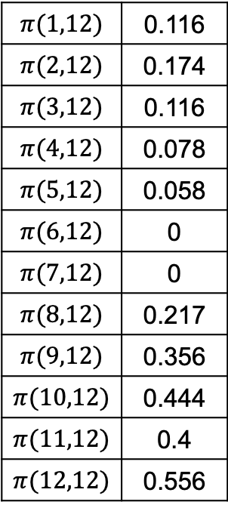


Single-Target PPR Query
9
10
12
2
($α=0.2$)
single-target PPR
1
8
$π(1,12)$ | 0.116
$π(2,12)$ | 0.174
$π(3,12)$ | 0.116
$π(4,12)$ | 0.078
$π(5,12)$ | 0.058
$π(6,12)$ | 0
$π(7,12)$ | 0
$π(8,12)$ | 0.217
$π(9,12)$ | 0.356
$π(10,12)$ | 0.444
$π(11,12)$ | 0.4
$π(12,12)$ | 0.556
3
11
4
6
5
7
Single-Target PPR:
the PPR value of every node to a given target node $t$.
Monte Carlo sampling CANNOT be applied to single-target PPR query.
Notes:
But things becomes difficult when we care about single-target PPR, that we need to derive the PPR value between every node and the given source node t.
(Click!)We find that Monte-Carlo sampling cannot be applied to single-target query because we cannot do the alpha walk starting from the target node t reversely.

Slide 7

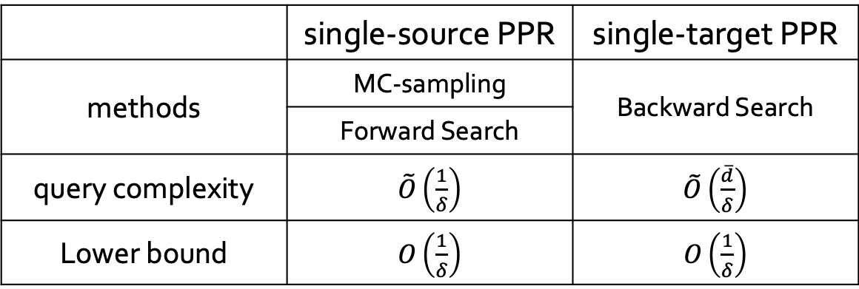
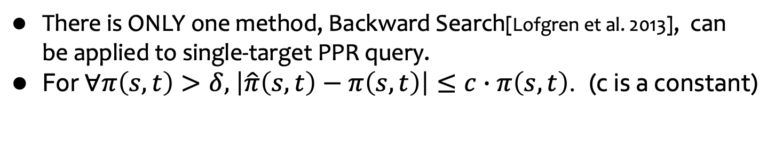
Theoretical Motivation
There is ONLY one method, Backward Search[Lofgren et al. 2013], can be applied to single-target PPR query.
For $∀π\left(s,t\right)>δ$, $\left|\hat{π}\left(s,t\right)−π\left(s,t\right)\right|≤c∙π\left(s,t\right)$. (c is a constant)
 | single-source PPR | single-target PPR
methods | MC-sampling | Backward Search
 | Forward Search
query complexity | $\tilde{Ο}\left(\frac{1}{δ}\right)$ | $\tilde{Ο}\left(\frac{\overline{d}}{δ}\right)$
Lower bound | $Ο\left(\frac{1}{δ}\right)$ | $Ο\left(\frac{1}{δ}\right)$
$Ο\left(\overline{d}\right)$ theoretical gap
Can we also achieve $Ο\left(\frac{1}{δ}\right)$ for single-target PPR query?
Notes:
In fact, there is only one method, Backward Search can be applied to single-target PPR query.
Same as before, (Click!)if we want to estimate the PPR value which is more than the threshold delta with relative error c and c is a constant, the Backward Search can return single-target PPR within the time d over delta. Here d is the average degree of the given graph.
(Click!)Recall that single-source PPR query can be finished in 1 over delta which is optimal and achieves the lower bound. However, the proved lower bound for single-target PPR query is 1 over delta. (Click!)So there is a d gap between Backward Search and the lower bound by theoretical analysis.
(Click!)Hence, there emerges an interesting question that can single-target query also achieve its lower bound 1 over delta like single-source PPR query does?

Slide 8
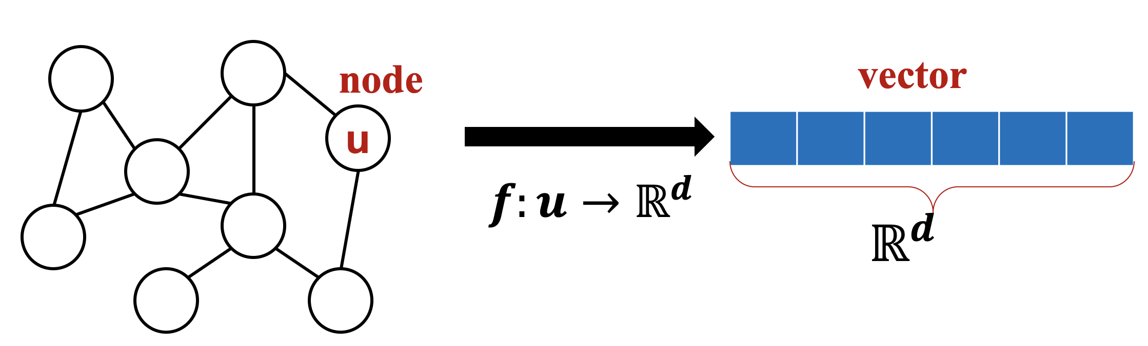
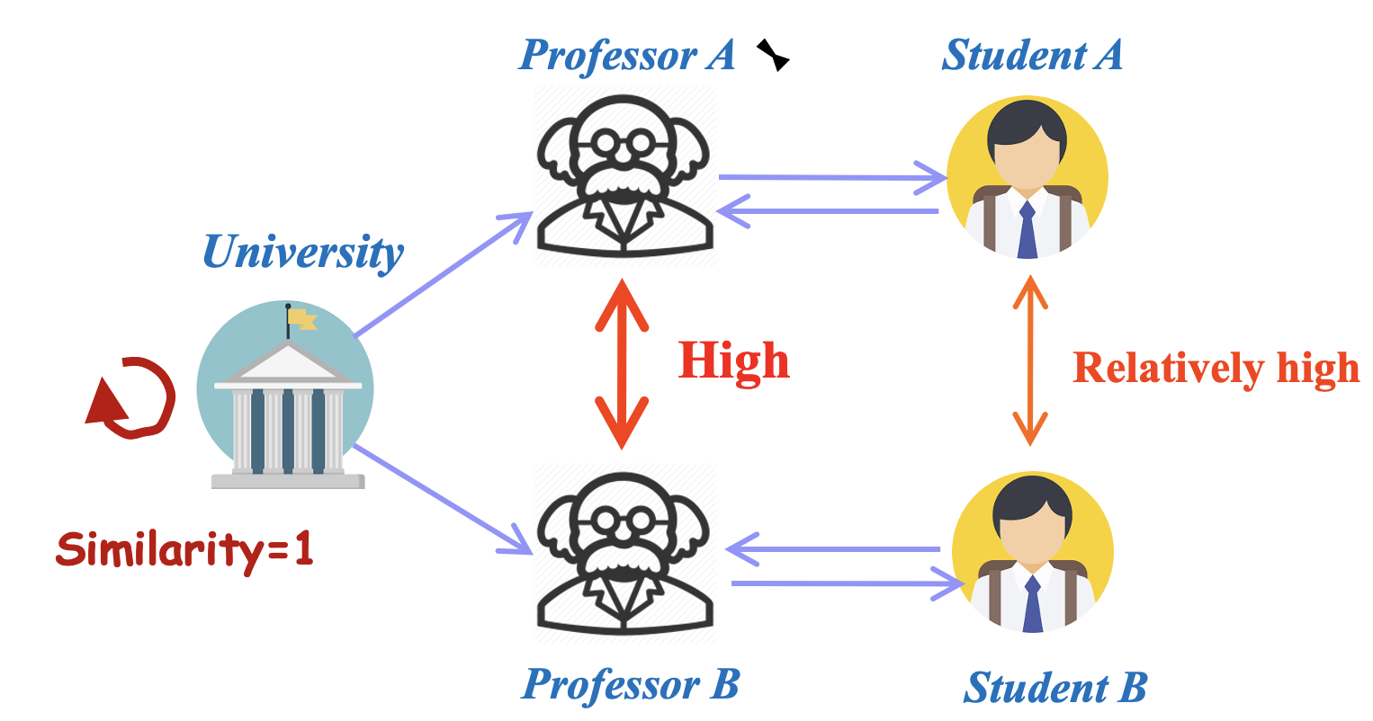
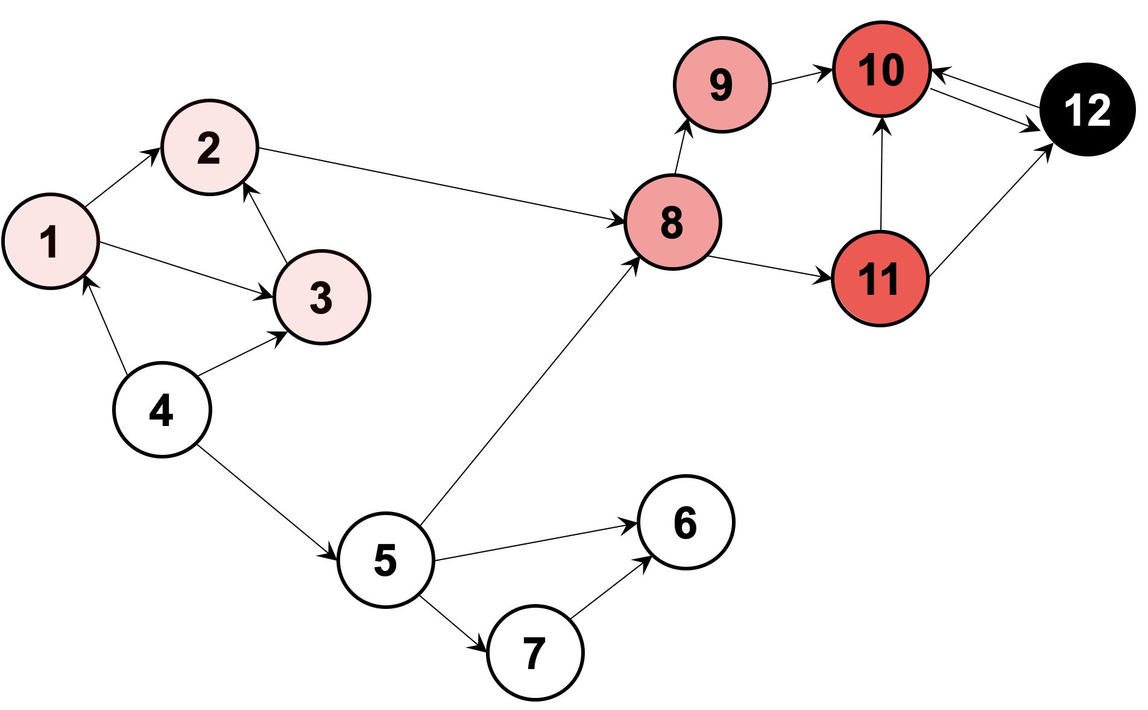
Single-Target PPR Applications
PPR heavy hitters query [Wang et al., SIGMOD’18]
SimRank computation [Wei et al., SIGMOD’19]
Graph embedding, graph neural networks (GNN)
[Yin et al., KDD’19] …
Notes:
Apart from the theoretical motivation to study single-target PPR, there are also lots of practical applications, such as
(Click!)PPR heavy hitters query,
(Click!)SimRank computation,
(Click!)Graph embedding and graph neural network and so on.
If we can improve the computational complexity of single-target PPR, we can simultaneously accelerate the query efficiency in these applications.

Slide 9
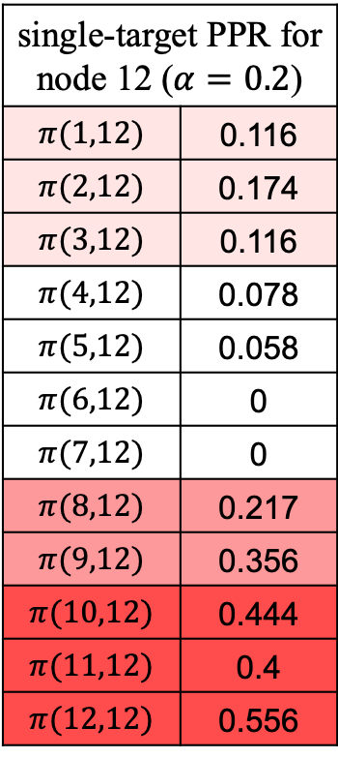

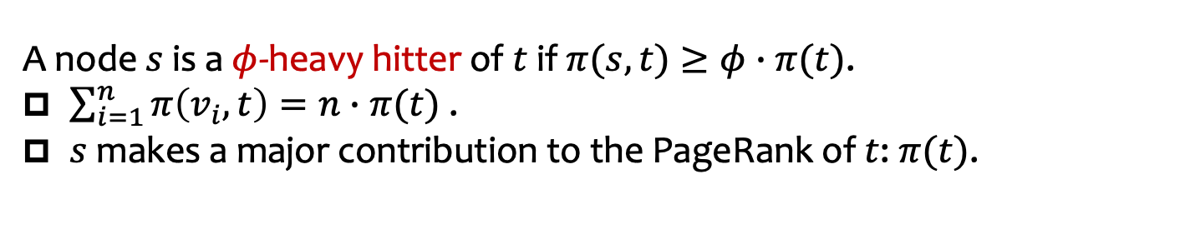
Application: PPR heavy hitters query
A node $s$ is a $φ$-heavy hitter of $t$ if $π(s,t)≥φ∙π(t)$.
$\sum_{i=1}^{n}{π\left(v_{i},t\right)=n∙π(t)}$ .
$s$ makes a major contribution to the PageRank of $t$: $π(t)$.
single-target PPR for node 12 ($α=0.2$)
$π(1,12)$ | 0.116
$π(2,12)$ | 0.174
$π(3,12)$ | 0.116
$π(4,12)$ | 0.078
$π(5,12)$ | 0.058
$π(6,12)$ | 0
$π(7,12)$ | 0
$π(8,12)$ | 0.217
$π(9,12)$ | 0.356
$π(10,12)$ | 0.444
$π(11,12)$ | 0.4
$π(12,12)$ | 0.556
$$π\left(12\right)=0.21$$
0.5-heavy hitters of node 12: node 1,2,3,8,9,10,11,12
Notes:
For example, as for PPR heavy hitters query, given a node t, we need to find all nodes s that the PPR value pi(s,t) exceeds phi times pi(t), where pi(t) is the PageRank of t.
(Click!)Because the sum of all single-target PPR values of t equals n times pi(t), (Click!)heavy hitters query wants to find those nodes who make a major contribution to pi(t). To find all heavy hitters, we should first derive the single-target PPR of node t, then pick out the nodes whose PPR values exceed phi times pi(t). In the example, we first calculate all single-target PPR values of node 12. Then we can easily pick out the corresponding nodes as heavy hitters. Therefore, single-target PPR query is a necessary step to find heavy hitters.

Slide 10


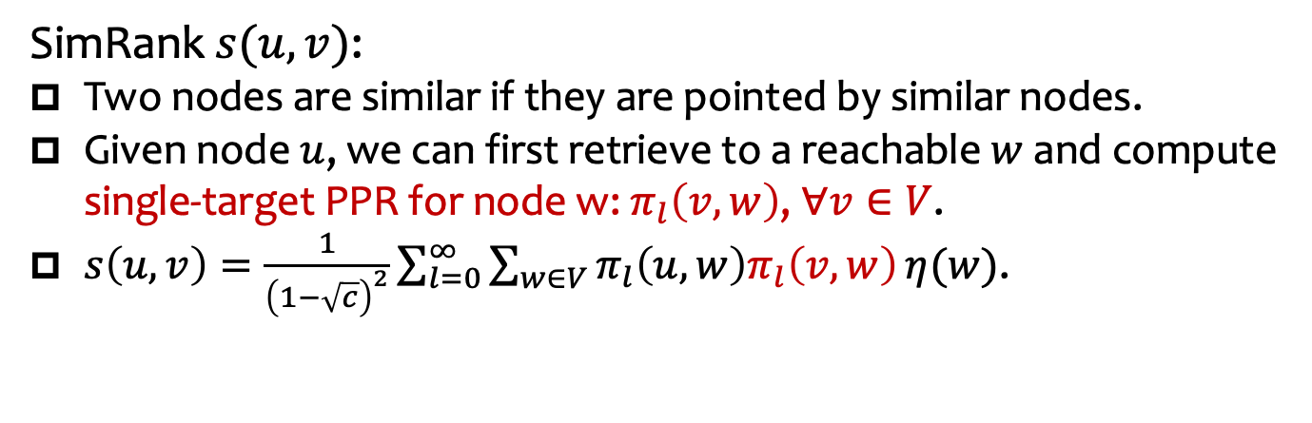











Application: SimRank computation
SimRank $s(u,v)$:
Two nodes are similar if they are pointed by similar nodes.
Given node $u$, we can first retrieve to a reachable $w$ and compute single-target PPR for node w: $π_{l}\left(v,w\right)$, $∀v∈V$.
$s\left(u,v\right)=\frac{1}{{\left(1−\sqrt{c}\right)}^{2}}\sum_{l=0}^{∞}{\sum_{w∈V}{π_{l}\left(u,w\right)π_{l}\left(v,w\right)}η(w)}$.
$$w_{3}$$
$$w_{2}$$
c
d
$$w_{1}$$
e
f
g
h
k
a
b
u
$$v_{1}$$
$$v_{2}$$
$$v_{3}$$
$$v_{4}$$
$$v_{5}$$
$$v_{6}$$
$$v_{7}$$
$$v_{8}$$
$$v_{9}$$
$$v_{10}$$
Notes:
Besides, in SimRank computation, we also need to compute single-target PPR. We know that SimRank is a measurement for node similarity and the high-level idea of SimRank is that two nodes are similar if they are pointed by similar nodes.
(Click!)Given a source node u, if we want to return the SimRanks between u and other nodes on graph.
(Click!)We can first generate a random walk and record the nodes the walk passes by as w to retrieve the nodes reachable from u.
(Click!)Then we reversely retrieve the nodes from w to find those nodes v which can reach w in the same length of walk as u. In this process, we can regard node w as the target node, and conduct single-target PPR to calculate the term pi(v,w) shown in the SimRank formula.

Slide 11
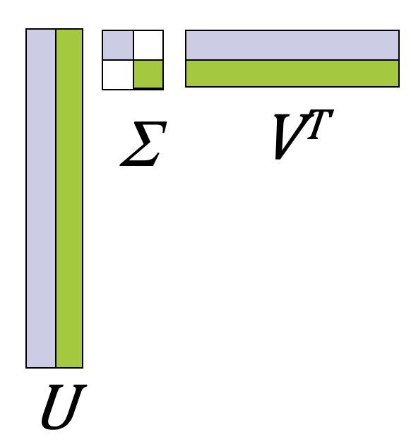
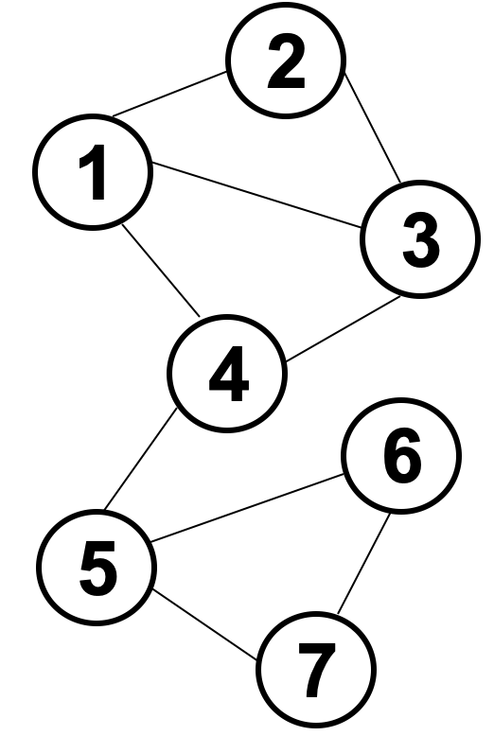
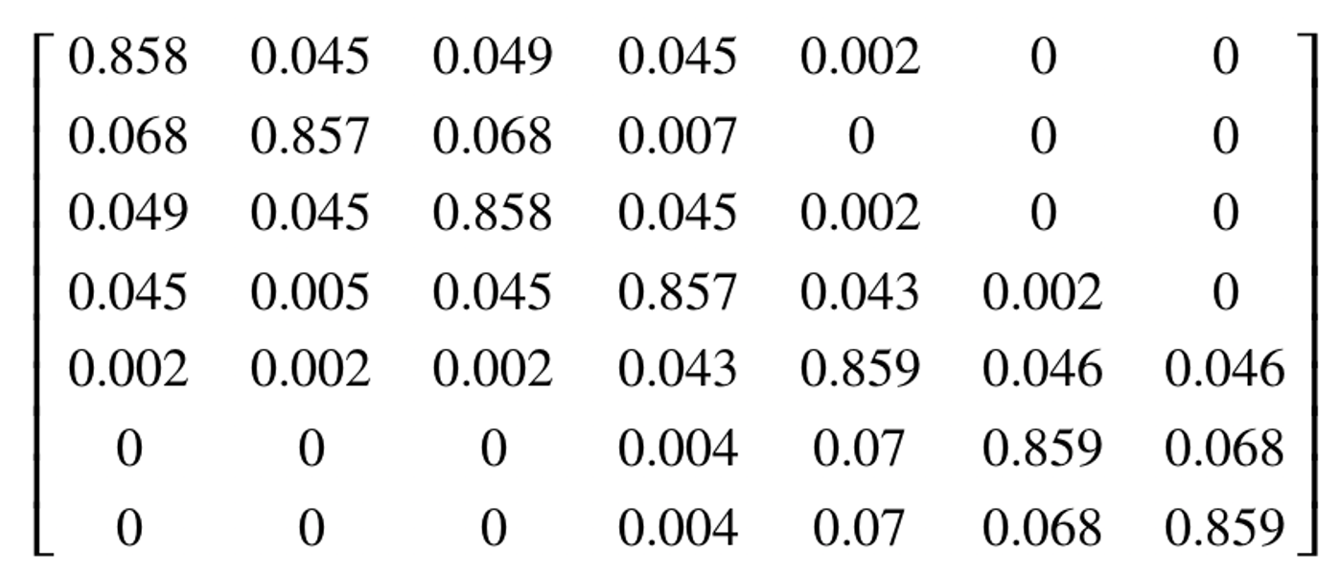

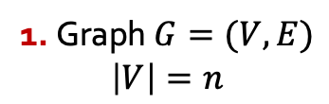

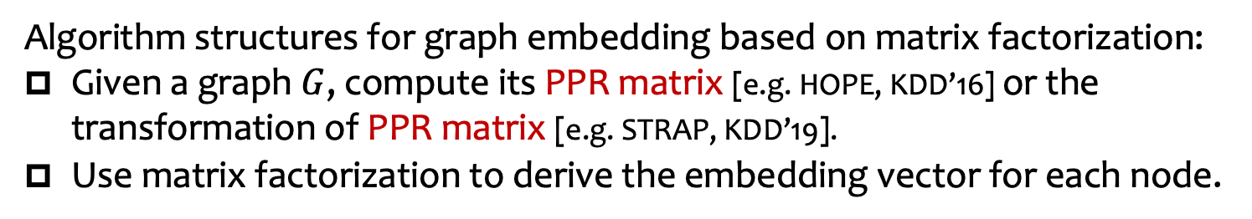





Application: graph embedding
Algorithm structures for graph embedding based on matrix factorization:
Given a graph $G$, compute its PPR matrix [e.g. HOPE, KDD’16] or the transformation of PPR matrix [e.g. STRAP, KDD’19].
Use matrix factorization to derive the embedding vector for each node.
PPR matrix
Apply single-source PPR query for each node as the source node.
Apply single-target PPR query for each node as the target node.
Better: more accurate for $ε$ additive error
$$ℝ^{d}$$
$v_{1}$:
matrix factorization
$v_{2}$:
$v_{3}$:
…
$v_{n}$:
1. Graph $G=(V,E)$
$$\left|V\right|=n$$
2. PPR matrix or its transformation
3. embedding vector for each node
Notes:
What’s more, in graph embedding, many algorithms follow the same structure that:
(Click!)calculate the PPR matrix or its transformation for the given graph first.
(Click)Then, use matrix factorization techniques to decompose PPR matrix and derive embedding vectors for each node.
(Click!)In the process, we need to compute the PPR matrix.
(Click!)We can conduct single-source PPR query for each node as source node,
(Click!)or apply single-target PPR query for each node as the target node.
(Click!)If we use additive error to bound the approximation quality, repeating single-target PPR query n times to derive the PPR matrix is better than single-source PPR and can achieve higher accuracy. Hence, single-target PPR plays a important role to derive PPR matrix.

Slide 12
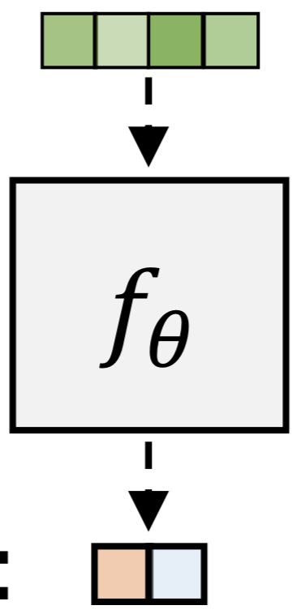
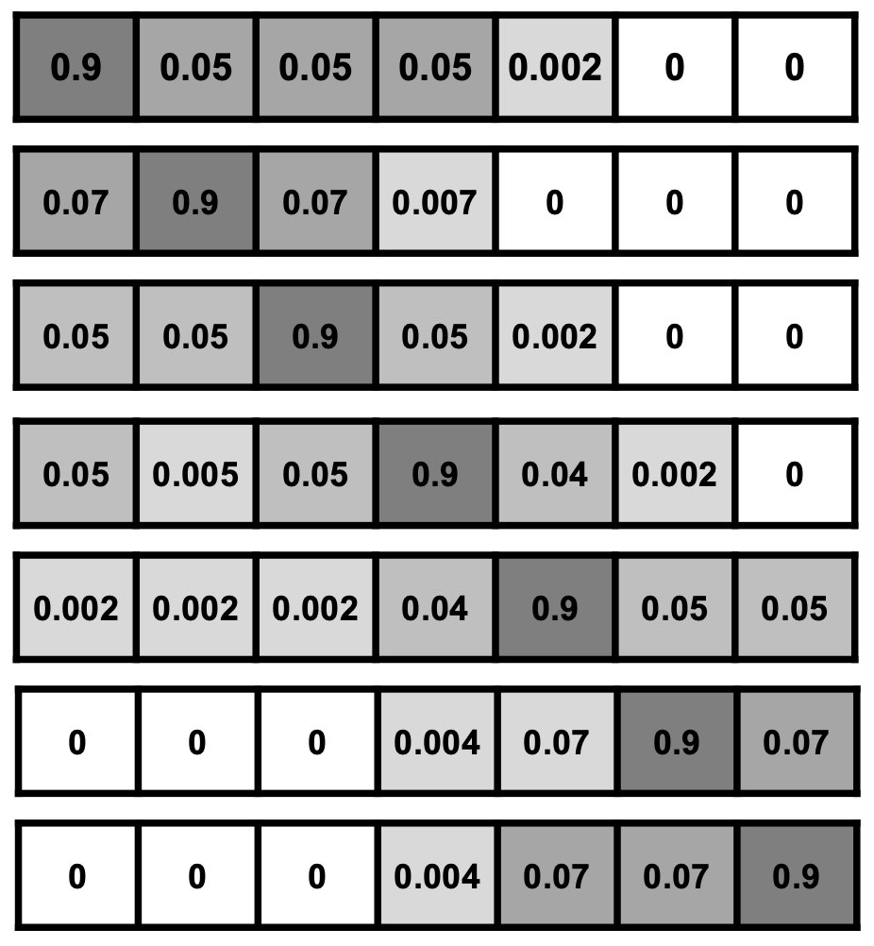
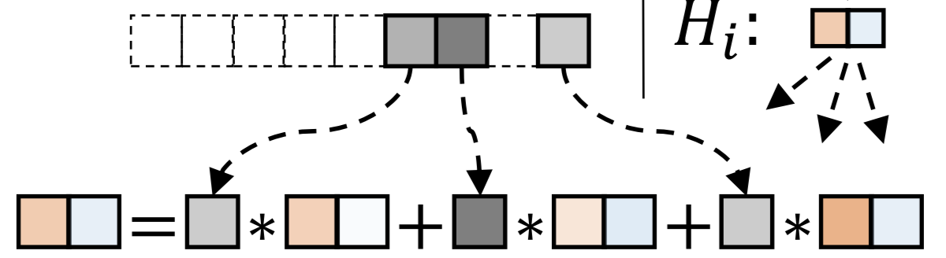








Application: graph neural networks (GNN)
Most graph neural networks apply message-passing framework:
Propagate node features along the neighbors.
Aggregate messages to obtain the updated representation for each node.
PPRGo[KDD’20]: use PPR matrix to propagate and aggregate information.
$x_{i}$:
feature vector for node $v_{i}$
training function
$H_{i}$:
individual prediction for node $v_{i}$
PPR vector for node $v_{i}$
$z_{i}$:
1. Graph $G=(V,E)$
2. PPR matrix
final prediction for node $v_{i}$
3. training: propagate and aggregate
Notes:
Similarly, in graph neural networks, or GNN for short, we still need to derive PPR matrix to propagate and aggregate messages.
(Click!)Take the work PPRGo as an example,
(Click!)it also compute the PPR matrix for the graph firstly.
(Click!)Then it regards PPR values as a kind of weight to propagate and aggerate the trained features for each node. In a word, single-target PPR has wide applications. The improvement of query speed for single-target PPR can directly affect these practical problems.

Slide 13
How?
Notes:
And here comes the question that how can we improve the computational complexity and eliminate the O(d) gap with the lower bound to accelerate the query speed of single-target PPR?

Slide 14

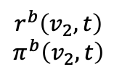
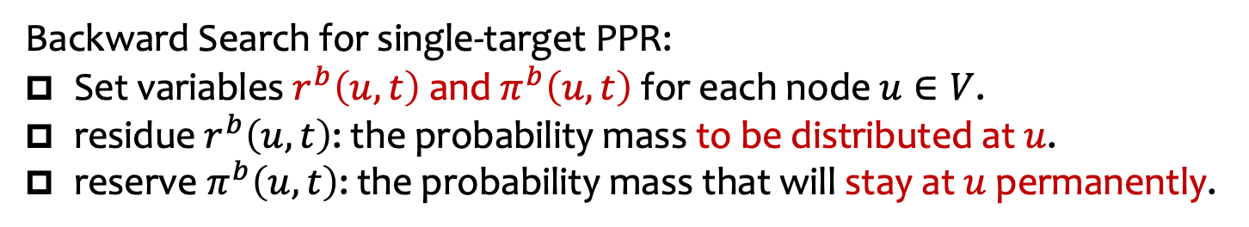


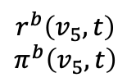

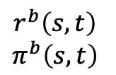

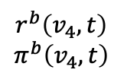
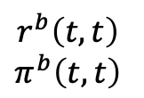


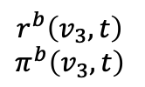
Vanilla Backward Search [Lofgren et al. 2013]
Backward Search for single-target PPR:
Set variables $r^{b}\left(u,t\right)$ and $π^{b}\left(u,t\right)$ for each node $u∈V$.
residue $r^{b}\left(u,t\right)$: the probability mass to be distributed at $u$.
reserve $π^{b}\left(u,t\right)$: the probability mass that will stay at $u$ permanently.
$$r^{b}\left(v_{1},t\right)$$
$$π^{b}\left(v_{1},t\right)$$
$$v_{1}$$
$$r^{b}\left(v_{2},t\right)$$
$$π^{b}\left(v_{2},t\right)$$
$$v_{2}$$
$$r^{b}\left(t,t\right)$$
$$π^{b}\left(t,t\right)$$
$$s$$
$$r^{b}\left(v_{3},t\right)$$
$$π^{b}\left(v_{3},t\right)$$
$$v_{3}$$
t
$$r^{b}\left(s,t\right)$$
$$π^{b}\left(s,t\right)$$
$$r^{b}\left(v_{4},t\right)$$
$$π^{b}\left(v_{4},t\right)$$
$$v_{4}$$
$$r^{b}\left(v_{5},t\right)$$
$$π^{b}\left(v_{5},t\right)$$
$$v_{5}$$
Notes:
As we mentioned before, Backward Search is the only existed method to calculate the single-target PPR. So we first clarify the running procedure of the vanilla Backward Search proposed by Lofgren in 2013. Then we explain the improvements of our method.
In Backward Search, with a given target node t, it will set two variables residue r(u,t) and reserve pi(u,t) for each node.
(Click!)The residue r(u,t) represents the probability mass to be distributed at u. (Click!)And reserve pi(u,t) denotes the probability mass that will stay at node u permanently.

Slide 15
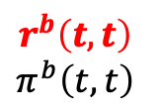
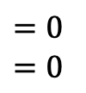
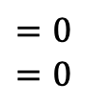
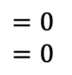
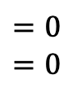
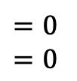
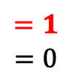
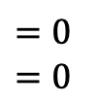
Vanilla Backward Search [Lofgren et al. 2013]
Backward Search for single-target PPR:
Set variables $r^{b}\left(u,t\right)$ and $π^{b}\left(u,t\right)$ for each node $u∈V$.
residue $r^{b}\left(u,t\right)$: the probability mass to be distributed at $u$.
reserve $π^{b}\left(u,t\right)$: the probability mass that will stay at $u$ permanently.
Initialize
$$r^{b}\left(v_{1},t\right)$$
$$π^{b}\left(v_{1},t\right)$$
$$=0$$
$$=0$$
$$v_{1}$$
$$r^{b}\left(v_{2},t\right)$$
$$π^{b}\left(v_{2},t\right)$$
$$=0$$
$$=0$$
$$v_{2}$$
$$r^{b}\left(t,t\right)$$
$$π^{b}\left(t,t\right)$$
$$=1$$
$$=0$$
$$s$$
$$r^{b}\left(v_{3},t\right)$$
$$π^{b}\left(v_{3},t\right)$$
$$=0$$
$$=0$$
$$v_{3}$$
t
$$r^{b}\left(s,t\right)$$
$$π^{b}\left(s,t\right)$$
$$=0$$
$$=0$$
$$r^{b}\left(v_{4},t\right)$$
$$π^{b}\left(v_{4},t\right)$$
$$=0$$
$$=0$$
$$v_{4}$$
$$r^{b}\left(v_{5},t\right)$$
$$π^{b}\left(v_{5},t\right)$$
$$=0$$
$$=0$$
$$v_{5}$$
Notes:
In the initialization, the residue and reserve of each node will be set as 0 except for the residue of the target node t r(t,t).
(Click!)We set r(t,t) as 1.

Slide 16


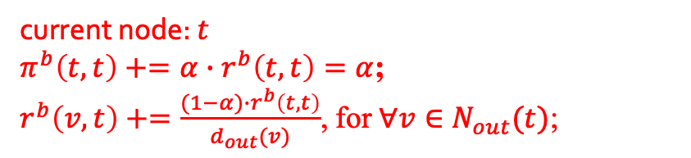






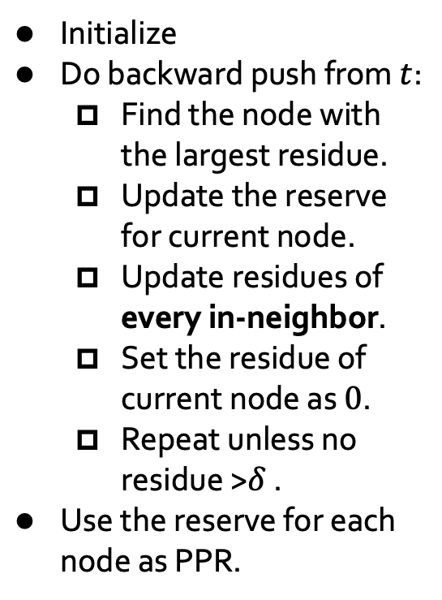


Vanilla Backward Search [Lofgren et al. 2013]
Backward Search for single-target PPR:
Set variables $r^{b}\left(u,t\right)$ and $π^{b}\left(u,t\right)$ for each node $u∈V$.
residue $r^{b}\left(u,t\right)$: the probability mass to be distributed at $u$.
reserve $π^{b}\left(u,t\right)$: the probability mass that will stay at $u$ permanently.
$$T\left(n\right)=Ο\left(\frac{\overline{d}}{δ}\right)$$
Initialize
Do backward push from $t$:
  Find the node with the largest residue.
  Update the reserve for current node.
  Update residues of every in-neighbor.
  Set the residue of current node as $0$.
  Repeat unless no residue >$δ$ .
Use the reserve for each node as PPR.
$=\frac{1−α}{1}$
$$r^{b}\left(v_{1},t\right)$$
$$π^{b}\left(v_{1},t\right)$$
$$=0$$
$$=0$$
$$v_{1}$$
$=\frac{1−α}{2}$
$$r^{b}\left(v_{2},t\right)$$
$$π^{b}\left(v_{2},t\right)$$
$$=0$$
$$=0$$
$$v_{2}$$
$$r^{b}\left(t,t\right)$$
$$π^{b}\left(t,t\right)$$
$$=1$$
$$=0$$
$$=α$$
$$=0$$
$$s$$
$=\frac{1−α}{3}$
$$r^{b}\left(v_{3},t\right)$$
$$π^{b}\left(v_{3},t\right)$$
$$=0$$
$$=0$$
$$v_{3}$$
t
$$r^{b}\left(s,t\right)$$
$$π^{b}\left(s,t\right)$$
$$=0$$
$$=0$$
  every in-neighbor.
$=\frac{1−α}{4}$
$$r^{b}\left(v_{4},t\right)$$
$$π^{b}\left(v_{4},t\right)$$
$$=0$$
$$=0$$
$$v_{4}$$
$=\frac{1−α}{5}$
$$r^{b}\left(v_{5},t\right)$$
$$π^{b}\left(v_{5},t\right)$$
$$=0$$
$$=0$$
$$v_{5}$$
current node: $t$
$π^{b}\left(t,t\right)+=α∙r^{b}\left(t,t\right)=α$;
$r^{b}\left(v,t\right)+=\frac{(1−α)∙r^{b}\left(t,t\right)}{d_{out}(v)}$, for $∀v∈N_{out}(t)$;
Notes:
Then we start to do the backward push from node t.
(Click!)First, we need to find the node with the largest residue, (Click!)currently it is node t.
(Click!)update the reserve of the current node by alpha times its residue. Currently, pi(t,t) equals 1. So we add alpha to pi(t,t).
(Click!)Next, we need to update the residue for each in-neighbor of current node t. We add 1 minus alpha times r(t,t) over the out-degree to the in-neighbors' residues. This equals the probability that one node v moves to node t in one step of alpha-discounted random walk. So the increment of in-neighbors residue by one push simulates the probability transformation in one-step of alpha-discounted random walk.
For example, because r(t,t) equals 1 and the out-degree of node
v one is 1. (Click!)So we add 1 minus alpha to r(v_one,t). Similarly, we add 1 minus alpha over two to r(v_2,t), 1 minus alpha over three to r(v_3,t), and so on.
(Click!)After this push, we set the residue of current node t r(t,t) as 0.(Click!)
(Click!)Repeat this process until we can not find a node whose residue is more than delta.
(Click!)Then we regard the reserve of each node as the estimation of its PPR value, and finish the vanilla Backward Search.
(Click!)Note that in each push operation, it will touch every in-neighbor of current node to update the residues.
(Click!)So the query time of vanilla Backward Search has the d parameter, where d is the average degree of the graph.

Slide 17



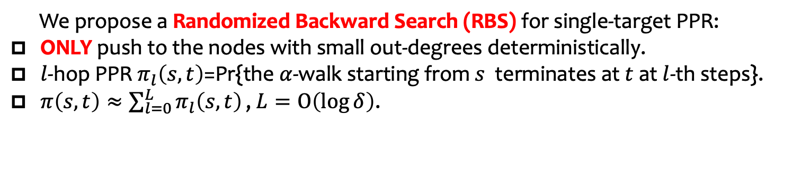
























Contribution: Randomized Backward Search
We propose a Randomized Backward Search (RBS) for single-target PPR:
ONLY push to the nodes with small out-degrees deterministically.
$l$-hop PPR $π_{l}\left(s,t\right)$=Pr{the $α$-walk starting from $s$ terminates at $t$ at $l$-th steps}.
$π\left(s,t\right)≈\sum_{l=0}^{L}{π_{l}\left(s,t\right)}\text{, }L=Ο\left(\log{δ}\right)\text{.}$
$π_{l}\left(v_{1},t\right)$
$$=0$$
$$v_{1}$$
Initialize
$∀l$ $∈[0,L]$
$π_{L}\left(t,t\right)$
$$=0$$
$π_{l}\left(v_{2},t\right)$
$$=0$$
$$v_{2}$$
…
$∀l$ $∈[0,L]$
$π_{1}\left(t,t\right)$
$$=0$$
$π_{0}\left(t,t\right)$
$$=α$$
$$s$$
$$v_{3}$$
$π_{l}\left(v_{3},t\right)$
$$=0$$
t
$π_{0}\left(s,t\right)$
$$=0$$
$∀l$ $∈[0,L]$
$π_{1}\left(s,t\right)$
$$=0$$
…
$π_{l}\left(v_{4},t\right)$
$$=0$$
$$v_{4}$$
$π_{L}\left(s,t\right)$
$$=0$$
$∀l$ $∈[0,L]$
$π_{l}\left(v_{5},t\right)$
$$=0$$
$$v_{5}$$
$∀l$ $∈[0,L]$
Notes:
Compared with vanilla Backward Search to touch every in-neighbor in each push operation, we propose a novel Randomized Backward Search, or RBS for short, and only do the push deterministically to the nodes with small out-degrees.
(Click!)Besides, we want to push by level. That is, we can compute l-hop PPR firstly and sum up all l-hop PPR for each level. In practice, we don’t need to add the l-hop PPR from level 0 to level infinity.
(Click!)The maximum level we care about is log delta. (Click!)
(Click!)In initialization, (Click!)we set every l-hop PPR as zero except for pi(t,t) at level zero as alpha. (Click!)

Slide 18









Contribution: Randomized Backward Search
We propose a Randomized Backward Search (RBS) for single-target PPR:
ONLY push to the nodes with small out-degrees deterministically.
$l$-hop PPR $π_{l}\left(s,t\right)$=Pr{the $α$-walk starting from $s$ terminates at $t$ at $l$-th steps}.
$π\left(s,t\right)≈\sum_{l=0}^{L}{π_{l}\left(s,t\right)}\text{, }L=Ο\left(\log{δ}\right)\text{.}$
$π_{0}\left(v_{1},t\right)$
$$v_{1}$$
$π_{l}\left(v_{1},t\right)$
$$=0$$
$$=0$$
Initialize
Run RBS from level $0$ to $L$.
For current level:
$∀l$ $∈[0,L]$
$π_{L}\left(t,t\right)$
$$=0$$
$π_{0}\left(v_{2},t\right)$
$$v_{2}$$
…
$π_{l}\left(v_{2},t\right)$
$$=0$$
$$=0$$
$π_{1}\left(t,t\right)$
$$=0$$
$∀l$ $∈[0,L]$
$π_{0}\left(t,t\right)$
$$=α$$
$$s$$
$$v_{3}$$
$π_{0}\left(v_{3},t\right)$
$π_{l}\left(v_{3},t\right)$
$$=0$$
$$=0$$
t
$π_{0}\left(s,t\right)$
$$=0$$
$∀l$ $∈[0,L]$
$π_{1}\left(s,t\right)$
$$=0$$
$π_{0}\left(v_{4},t\right)$
$$v_{4}$$
$π_{l}\left(v_{4},t\right)$
$$=0$$
…
$$=0$$
$π_{L}\left(s,t\right)$
$$=0$$
$∀l$ $∈[0,L]$
$π_{0}\left(v_{5},t\right)$
$$v_{5}$$
$π_{l}\left(v_{5},t\right)$
$$=0$$
$$=0$$
$∀l$ $∈[0,L]$
Notes:
Then we conduct RBS from level 0 to level capital L.
(Click!)For current level, level 0 in the example.

Slide 19















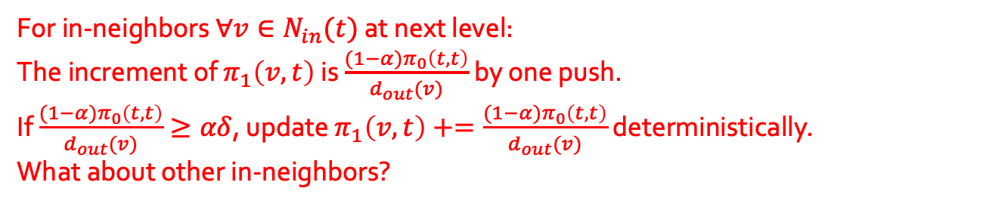

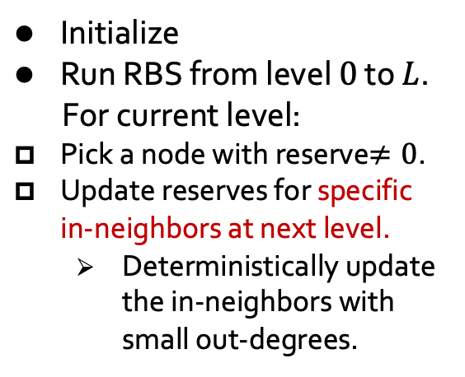








Contribution: Randomized Backward Search
We propose a Randomized Backward Search (RBS) for single-target PPR:
ONLY push to the nodes with small out-degrees deterministically.
$l$-hop PPR $π_{l}\left(s,t\right)$=Pr{the $α$-walk starting from $s$ terminates at $t$ at $l$-th steps}.
$π\left(s,t\right)≈\sum_{l=0}^{L}{π_{l}\left(s,t\right)}\text{, }L=Ο\left(\log{δ}\right)\text{.}$
$v_{3}:\frac{(1−α)π_{0}\left(t,t\right)}{3}<αδ$
$v_{2}:\frac{(1−α)π_{0}\left(t,t\right)}{2}≥αδ$
$π_{0}\left(v_{1},t\right)$
$$=0$$
$$v_{1}$$
$v_{1}:\frac{(1−α)π_{0}\left(t,t\right)}{1}≥$𝜶𝛿
Initialize
Run RBS from level $0$ to $L$.
For current level:
Pick a node with reserve$≠0$.
Update reserves for specific in-neighbors at next level.
  Deterministically update the in-neighbors with small out-degrees.
$π_{1}\left(v_{1},t\right)$
$=\frac{(1−α)α}{1}$
$π_{0}\left(v_{2},t\right)$
$$=0$$
$$v_{2}$$
$π_{1}\left(v_{2},t\right)$
$=\frac{(1−α)α}{2}$
$π_{0}\left(t,t\right)$
$$=α$$
$$s$$
$$v_{3}$$
$π_{0}\left(v_{3},t\right)$
$$=0$$
t
$π_{0}\left(s,t\right)$
$$=0$$
$π_{0}\left(v_{4},t\right)$
$$=0$$
$$v_{4}$$
For in-neighbors $∀v∈N_{in}(t)$ at next level:
The increment of $π_{1}\left(v,t\right)$ is $\frac{(1−α)π_{0}\left(t,t\right)}{d_{out}(v)}$ by one push.
If $\frac{(1−α)π_{0}\left(t,t\right)}{d_{out}(v)}≥αδ$, update $π_{1}\left(v,t\right)+=\frac{(1−α)π_{0}\left(t,t\right)}{d_{out}(v)}$ deterministically.
What about other in-neighbors?
$π_{0}\left(v_{5},t\right)$
$$=0$$
$$v_{5}$$
Notes:
We first pick a node with nonzero reserve. In this example, we pick node t.
(Click!)Then we update the reserve for the in-neighbors of node t.
(Click!)As we mentioned before, we only do the push operation deterministically to the in-neighbors with small out-degrees. .
(Click!)Note that for any in-neighbors v of node t, the increment of reserve pi(v,t) at level 1 is 1 minus alpha times pi(t,t) at level 0 divided by v’s out-degree and is decreased by the out-degree of v.
Small out-degrees mean large reserve increments.
(Click!)So we only push to the in-neighbors whose reserve will be increased by more than alpha times delta.
In this example, we check if the reserve’s increment of the picked in-neighbors whether exceeds alpha times delta, and update the reserve if satisfied.
(Click)Here, suppose node v_one satisfies the requirement. (Click!)So we add 1 minus alpha times alpha to pi(v_one,t) at level 1 because the out-degree of v_1 is one and the reserve of pi(t,t) at level zero is alpha.
(Click!)Similarly, we check node v_2. Suppose v_2 also satisfy the requirement. So we add 1 minus alpha times alpha over 2 to pi(v_two,t) at level 0.
(Click!)Then we check node v_three. But if the out-degree of v_three is so large that the increment of its reserve is less than alpha times delta.
(Click!)What should we do? Can we straightly ignore other in-neighbors? The answer is no.

Slide 20
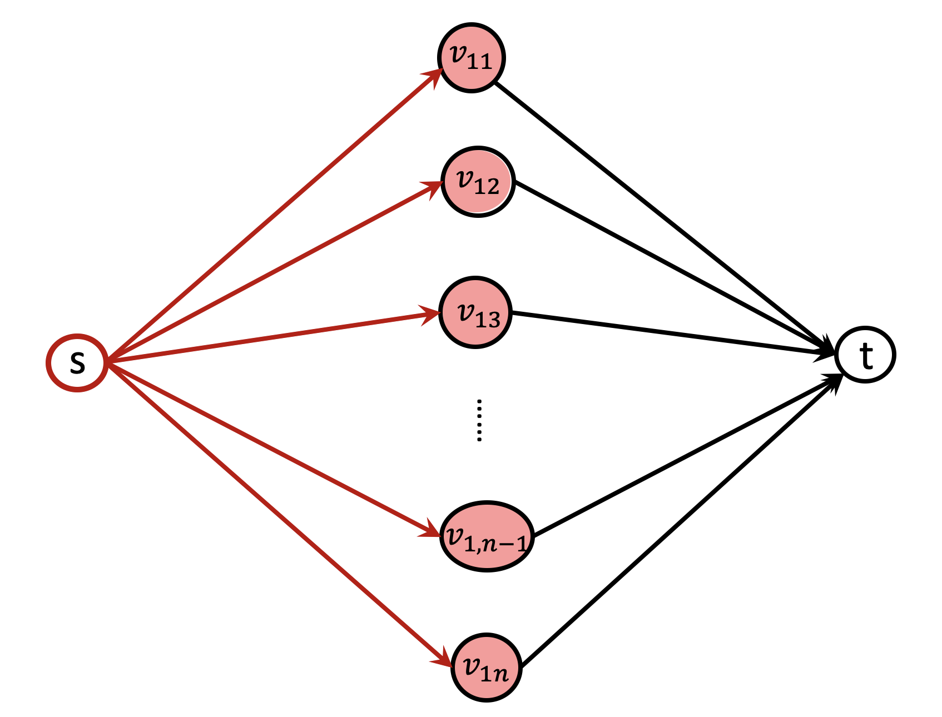











Contribution: Randomized Backward Search
$π_{1}\left(v,t\right)=α∙\left(1−α\right)$
Suppose $δ=\frac{1}{n}$ :
$$s: \frac{(1−α)π_{1}\left(v,t\right)}{d_{out}(s)}=\frac{{α∙\left(1−α\right)}^{2}}{n}<αδ=\frac{α}{n}$$
$$d_{out}\left(s\right)=n$$
$$π_{0}\left(t,t\right)=α$$
$$π_{1}\left(s,t\right)=0$$
$$π_{0}\left(s,t\right)=0$$
$π_{2}\left(s,t\right)=0$
$\hat{π}\left(s,t\right)=\sum_{l}{π_{l}(s,t)}=0$
$$π\left(s,t\right)={α∙\left(1−α\right)}^{2}$$
For in-neighbors $∀v∈N_{in}(t)$ at next level:
If $\frac{(1−α)π_{0}\left(t,t\right)}{d_{out}(v)}≥αδ$, update $π_{1}\left(v,t\right)+=\frac{(1−α)π_{0}\left(t,t\right)}{d_{out}(v)}$ deterministically.
We CANNOT bound the error range if we ignore the nodes not be pushed deterministically
Notes:
For example, in this case,
(Click!)pi_zero(t,t) equals alpha,
Because the out-degrees of node v_11 to v_1n are all 1, (Click!)the one-hop PPR of node v_11 to v_1n are all alpha times (1 minus alpha). Now we have to check the out-degree of node s and decide whether to do the backward push from each v to node s.
(Click!)Note that the out-degree of s is n.
(Click!)Suppose we set delta equals 1 over n,
(Click!)then the reserve’s increment by one push from any v to s is alpha times (the square of 1 minus alpha) over n, which is smaller than alpha times delta.
(Click!)So according to the condition of push mentioned before, we will not do the push from every node v to s.(Click!)
(Click!)And this causes the estimated PPR pi(s,t) equals 0.
(Click!)But the true value of pi(s,t) is alpha times (the square of 1 minus alpha) over n, and is much larger than the estimated pi(s,t).
(Click!)So if we just ignore the other in-neighbors which are not be pushed deterministically, we can not bound the estimated PPR within the required error range.

Slide 21



Contribution: Randomized Backward Search
We propose a Randomized Backward Search (RBS) for single-target PPR:
ONLY push to the nodes with small out-degrees deterministically.
$l$-hop PPR $π_{l}\left(s,t\right)$=Pr{the $α$-walk starting from $s$ terminates at $t$ at $l$-th steps}.
$π\left(s,t\right)≈\sum_{l=0}^{L}{π_{l}\left(s,t\right)}$, $L=Ο\left(\log{δ}\right)$.
$π_{0}\left(v_{1},t\right)$
$$=0$$
$$v_{1}$$
Initialize
Run RBS from level $0$ to $L$.
For current level:
Pick a node with reserve$≠0$.
Update reserves for specific in-neighbors at next level.
  Deterministically update the in-neighbors with small out-degrees.
$π_{1}\left(v_{1},t\right)$
$=\frac{(1−α)α}{1}$
$π_{0}\left(v_{2},t\right)$
$$=0$$
$$v_{2}$$
$π_{1}\left(v_{2},t\right)$
$=\frac{(1−α)α}{2}$
$π_{0}\left(t,t\right)$
$$=α$$
$$s$$
$$v_{3}$$
$π_{0}\left(v_{3},t\right)$
$$=0$$
t
$π_{0}\left(s,t\right)$
$$=0$$
$π_{0}\left(v_{4},t\right)$
$$=0$$
$$v_{4}$$
$π_{0}\left(v_{5},t\right)$
$$=0$$
$$v_{5}$$
How about sampling the in-neighbors w.p. $\frac{1}{αδ}∙\frac{(1−α)π_{0}\left(t,t\right)}{d_{out}(v)}$ and increase the reserve by $αδ$ to guarantee unbiasedness (the expected increments for reserve is still $\frac{(1−α)π_{0}\left(t,t\right)}{d_{out}(v)}$ ).
Notes:
(Click!)Well then, how about sampling some in-neighbors and only increase the reserve of these in-neighbors？This sounds good. We can sample the in-neighbors with the probability 1 over alpha delta times the expected increment value. And update the reserve of sampled nodes alpha times delta to guarantee unbiasedness. (Click!)

Slide 22

Contribution: Randomized Backward Search
We propose a Randomized Backward Search (RBS) for single-target PPR:
ONLY push to the nodes with small out-degrees deterministically.
$l$-hop PPR $π_{l}\left(s,t\right)$=Pr{the $α$-walk starting from $s$ terminates at $t$ at $l$-th steps}.
$π\left(s,t\right)≈\sum_{l=0}^{L}{π_{l}\left(s,t\right)}\text{, }L=Ο\left(\log{δ}\right)\text{.}$
$π_{0}\left(v_{1},t\right)$
$$=0$$
$$v_{1}$$
Initialize
Run RBS from level $0$ to $L$.
For current level:
Pick a node with reserve$≠0$.
Update reserves for specific in-neighbors at next level.
  Deterministically update the in-neighbors with small out-degrees.
$π_{1}\left(v_{1},t\right)$
$=\frac{(1−α)α}{1}$
$π_{0}\left(v_{2},t\right)$
$$=0$$
$$v_{2}$$
$π_{1}\left(v_{2},t\right)$
$=\frac{(1−α)α}{2}$
$π_{0}\left(t,t\right)$
$$=α$$
$$s$$
$$v_{3}$$
$π_{0}\left(v_{3},t\right)$
$$=0$$
t
$π_{0}\left(s,t\right)$
$$=0$$
$π_{0}\left(v_{4},t\right)$
$$=0$$
$$v_{4}$$
How to sample?
We CANNOT generate the random numbers
for every other in-neighbors, because this still will cost $O\left(\overline{d}\right)$.
We can ONLY generate one random number $r∈\left[0,1\right]$ for all in-neighbors, and check whether
$r<\frac{1}{αδ}∙\frac{\left(1−α\right)π_{0}\left(t,t\right)}{d_{out}\left(v\right)}$. And $π(v,t)$ increases by the push from its out-edges, which is independent.
$π_{0}\left(v_{5},t\right)$
$$=0$$
$$v_{5}$$
Notes:
But the question is: how to sample these in-neighbors.
(Click!)We can not generate the random number for every other in-neighbors, because this still touches every in-neighbors and does not save time.
(Click!)Can we only generate one random number r for all in-neighbors. Even though the generation process is not independent for each in-neighbors, we only need the reserve pi(v,t) is increased by independent push from its out-neighbors, which is satisfied in RBS.(Click!)

Slide 23

Contribution: Randomized Backward Search
We propose a Randomized Backward Search (RBS) for single-target PPR:
ONLY push to the nodes with small out-degrees deterministically.
$l$-hop PPR $π_{l}\left(s,t\right)$=Pr{the $α$-walk starting from $s$ terminates at $t$ at $l$-th steps}.
$π\left(s,t\right)≈\sum_{l=0}^{L}{π_{l}\left(s,t\right)}\text{, }L=Ο\left(\log{δ}\right)\text{.}$
$π_{0}\left(v_{1},t\right)$
$$=0$$
$$v_{1}$$
Initialize
Run RBS from level $0$ to $L$.
For current level:
Pick a node with reserve$≠0$.
Update reserves for specific in-neighbors at next level.
  Deterministically update the in-neighbors with small out-degrees.
$π_{1}\left(v_{1},t\right)$
$=\frac{(1−α)α}{1}$
$π_{0}\left(v_{2},t\right)$
$$=0$$
$$v_{2}$$
$π_{1}\left(v_{2},t\right)$
$=\frac{(1−α)α}{2}$
$π_{0}\left(t,t\right)$
$$=α$$
$$s$$
$$v_{3}$$
$π_{0}\left(v_{3},t\right)$
$$=0$$
t
$π_{0}\left(s,t\right)$
$$=0$$
$π_{0}\left(v_{4},t\right)$
$$=0$$
$$v_{4}$$
$π_{0}\left(v_{5},t\right)$
$$=0$$
$$v_{5}$$
Note that $\frac{1}{αδ}∙\frac{\left(1−α\right)π_{0}\left(t,t\right)}{d_{out}\left(v\right)}$ is decrease by $d_{out}\left(v\right)$.
So we can sort the in-neighbors in ascending order of their out-degrees during graph input.
Scan the in-neighbors of $t$ and stop when we first meet the the node with $r>\frac{1}{αδ}∙\frac{\left(1−α\right)π_{0}\left(t,t\right)}{d_{out}\left(v\right)}$.
Notes:
Note that the sampling probability for each in-neighbors is decreased by its out-degree. So we can sort the in-neighbors in ascending order of their out-degrees during graph input.
(Click!)Scan the in-neighbors and stop immediately once we meet the node whose out-degree is quite large and is less likely to be sampled.(Click!)

Slide 24






Contribution: Randomized Backward Search
We propose a Randomized Backward Search (RBS) for single-target PPR:
ONLY push to the nodes with small out-degrees deterministically.
$l$-hop PPR $π_{l}\left(s,t\right)$=Pr{the $α$-walk starting from $s$ terminates at $t$ at $l$-th steps}.
$π\left(s,t\right)≈\sum_{l=0}^{L}{π_{l}\left(s,t\right)}\text{, }L=Ο\left(\log{δ}\right)\text{.}$
$v_{3}:r≥\frac{1}{αδ}∙\frac{(1−α)π_{0}\left(t,t\right)}{3}$
$$v_{1}$$
$v_{4}:r≤\frac{1}{αδ}∙\frac{(1−α)π_{0}\left(t,t\right)}{4}$
$π_{0}\left(v_{1},t\right)$
$$=0$$
Initialize
Run RBS from level $0$ to $L$.
For current level:
Pick a node with reserve$≠0$.
Update reserves for specific in-neighbors at next level.
  Deterministically update the in-neighbors with small out-degrees.
  Update the in-neighbors by sampling.
Repeat unless no nonzero nodes. Move to next level.
Regard $\sum_{l=0}^{L}{π_{l}\left(s,t\right)}$ for each node as PPR.
$π_{1}\left(v_{1},t\right)$
$=\frac{(1−α)α}{1}$
Stop checking!
$π_{0}\left(v_{2},t\right)$
$$=0$$
$$v_{2}$$
$π_{1}\left(v_{2},t\right)$
$=\frac{(1−α)α}{2}$
$π_{0}\left(t,t\right)$
$$=α$$
$$s$$
$$v_{3}$$
$π_{0}\left(v_{3},t\right)$
$$=0$$
t
$π_{0}\left(s,t\right)$
$$=0$$
$π_{1}\left(v_{3},t\right)$
$=αδ$
$π_{0}\left(v_{4},t\right)$
$$=0$$
$$v_{4}$$
$π_{0}\left(v_{5},t\right)$
$$=0$$
$$v_{5}$$
Scan the in-neighbors of $t$ and stop when we first meet the the node with $r>\frac{1}{αδ}∙\frac{\left(1−α\right)π_{0}\left(t,t\right)}{d_{out}\left(v\right)}$.
Notes:
In the example, we have sorted the five nodes v_1 to v_5 in the ascending order of their out-degrees. (Click!)Scan the nodes that have not been pushed. Check the sampling probability whether larger than the random number r.(Click!)
V_three is satisfied and we add alpha times delta to pi(v_three,t).
But v_four doesn’t.
So we just stop checking and finish this push.
(Click!)Repeat finding the nodes with nonzero reserve. Then move to next level.
(Click!)After the process, we use the sum of the l-hop PPR from level 0 to level capital L as the estimation of single-target PPR for each node.

Slide 25




Contribution: Randomized Backward Search
Properties of Randomized Backward Search (RBS) :
In each push operation, RBS does not have to touch every in-neighbor.
RBS returns unbiased estimations for single-target PPR via randomness.
We can adjust the push condition to for additive error $ε$.
We can sort each node’s in-neighbors in the ascending order of out-degrees when read graph using counting sort. ($T\left(n\right)=Ο\left(\left|E\right|+\left|V\right|\right)$).
the reserve’s increment for node $v∈N_{in}\left(t\right)$ in the push from $t$ at level $0$: $\frac{(1−α)π_{0}\left(t,t\right)}{d_{out}(v)}$
 | relative threshold $δ$ | additive error $ε$
$$T\left(n\right)$$ | $$Ο\left(1/δ\right)$$ | $Ο\left(\sqrt{\overline{d}}/ε\right)$
push | if increments $≥αδ$ | if increments$≥\frac{αε}{\sqrt{d_{out}(v)}}$
push by random $r$ | else if increments$≥rαδ$ | else if increments$≥\frac{rαε}{\sqrt{d_{out}(v)}}$
no push | else increments$<rαδ$ | else increments$<\frac{rαε}{\sqrt{d_{out}(v)}}$
Notes:
Recall that in the running process of RBS, we adopt randomness to avoid touch every in-neighbor and achieve unbiasedness. So we will not cost O(d) in each push and eliminate the d gap with the lower bound.
(Click!)Specifically, we can achieve 1 over delta with the relative threshold delta. And the square root of d over epsilon with additive error parameter epsilon.
(Click!)Besides, we can sort each node’s in-neighbors in the ascending order of out-degrees when we read graph. If we use counting sort, the time cost to sort out-neighbors will remain the same with reading graph.

Slide 26


Experiments
Datasets:
Competitor: vanilla Backward Search
Metrics:
  MaxAdditiveError = $\frac{1}{n}\max_{1≤i≤n}{|\tilde{π}\left(v_{i},t\right)−π(v_{i},t)|}$
  precision@k = $\frac{\left|\{real top−k nodes\}∩\{estimated top−k nodes\}\right|}{k}$
  F1 score = $\frac{2∙precision∙recall}{precision+recall}$ (for PPR heavy hitters query)
K=50
Dataset source: http://snap.stanford.edu/data/index.html. http://law.di.unimi.it/datasets.php.
Notes:
In the experiment part, we conduct comprehensive experiments to evaluate the performance of RBS compared with vanilla Backward Search.
We use maxAdditiveError, precision and F1 score as our metrics.

Slide 27


Experiments
MaxAdditiveError v.s. query time for additive error $ε$
Notes:
We first plot the trade-offs between maxAdditiveErro and query time to show the performance of RBS with additive error epsilon.
We can observe that RBS shown in the green line outperforms vanilla Backward Search under the same approximation quality.

Slide 28


Experiments
precision@50 v.s. query time for relative threshold $δ$
Notes:
As for the relative error, because there lacks a practical metric. So we use precision for top fifty nodes to evaluate BRS’s performance. We can observe that within the same query time, RBS can achieve higher precision than Backward Search.

Slide 29


Experiments - PPR heavy hitters query
F1 score v.s. query time for heavy hitters
Notes:
Beyond that, we also apply RBS to the three concrete applications, PPR heavy hitter query, SimRank computation, PPR matrix in graph embedding and graph neural network.
In the PPR heavy query, we substitute the Backward Search with RBS to find heavy hitters, and we use f1 score to evaluate the performances since the number of true heavy hitters is oblivious. The experimental results show that RBS returns a higher F1 score than Backward Search does.

Slide 30


Experiments - SimRank computation
SimRank $s\left(u,v\right)=\frac{1}{{\left(1−\sqrt{c}\right)}^{2}}\sum_{l=0}^{∞}{\sum_{w∈V}{π_{l}\left(u,w\right)π_{l}\left(v,w\right)}η(w)}$.
PRSim [Wei et al. SIGMOD’19] pre-computes $π_{l}\left(v,w\right)$ for target $w$ using vanilla Backward Search.
MaxAdditiveError v.s. preprocessing time in PRSim
Notes:
In SimRank computation, the state-of-the-art method PRSim precompute the single-target PPR pi(v,w) with vanilla Backward Search in the preprocessing phase and store them in index. We institute the Bakcward Search with RBS and plot the trade-off between maxadditiveError and preprocessing time. We observe that RBS achieve a lower preprocessing time without increasing the approximation quality.

Slide 31

Experiments:
PPR matrix in graph embedding or GNN
PPR matrix: apply single-target PPR query for each node as the target node.
We compare with vanilla Backward Search and Forward Search to compute PPR matrix.
MaxAdditiveError v.s. running time
Notes:
Finally, we apply single-target PPR for each node as target node to derive the PPR matrix. As we mention before, in order to derive PPR matrix, we can apply single-target PPR for each node as target node or single-source PPR for each node as source node. But single-target PPR can achieve higher accuracy than single-source PPR when we comes to additive error. In our experiment, we not only compare RBS with vanilla Backward Search, but also with Forward Search, the method to compute single-source PPR. We can observe that Backward Search and RBS both outperform Forward Search, which concurs with our analysis. Meanwhile, RBS can further improve the trade-offs between the running time and the approximation quality compared with Backward Search.

Slide 32

Conclusion
RBS can achieve $Ο\left(\frac{1}{δ}\right)$ for relative threshold $δ$, or $Ο\left(\frac{\sqrt{\overline{d}}}{ε}\right)$ for additive error $ε$ for single-target PPR query.
RBS successfully eliminates the $Ο\left(\overline{d}\right)$ gap with the lower bound for single-target PPR with the relative threshold $δ$.
RBS can be applied to many applications and increase their performance, such as PPR heavy hitters query, SimRank computation, graph embedding, GNN and so on.
Notes:
In conclusion, RBS can achieve 1 over delta for constant relative error and threshold delta, or the sqrt of d over epsilon for additive error epsilon.
(Click!)Because of this, RBS successfully eliminates the O(d) gap with the lower bound for single-target PPR with the relative threshold delta.
(Click!)Besides, RBS can be applied to many applications and further increase their performance, such as PPR heavy hitters query, SimRank computation, graph embedding, GNN and so on.

Slide 33
Thank you!
Personalized PageRank to a Target Node, Revisited
Notes:
That’s all of our presentation. Thank you.

